Slide 1
Research Facilities
Department of Physics
Birla Institute of Technology
Mesra, Ranchi

Slide 2
Project Proposals Submitted (2021)
Submitted by | Submitted to | Amount requested
1.Modulation in Aerosol Radiative forcing: Investigations on Composition Dependence
Dr. Nishi Srivastava | SERB | 26.40 Lakh
2. Graphene Oxide based quasi-solid electrolytes for next generation Solar Cells
Dr. Rishi Sharma | DST | 34.96 Lakh
3. Mechanically stable transparent conducting oxides for flexible solar cells
Dr. S. K. Mukherjee | SERB (Core Research Grant) | 28.96 Lakh
4. Biocompatibility and mechanical studies of nanostructured HAP, metal doped nanostructured HAP on alumina by RF Magnetron Sputtering
Dr. S. K. Sinha, Co-PI | DST-SERB
5. Development of efficient cathode materials for solid oxide electrolyte cell (SOEC) applications
Dr. Ela Sinha | DST-SERB | 41.14 Lakh
6. Development of environment friendly and efficient electrocaloric material for solid state self-cooling device applications
Dr. S. K. Rout | DST-SERB | 58.68 Lakh

Slide 3
Projects (Ongoing)
1. Investigation on Optical Pulse and Beam Propagation in Semiconductor Quantum Well and Quantum Dot Nanostructures with Emphasis to the Development of Photonic Device
Prof S. Konar (PI ), Dr K Bose (CI) |  | DRDO | 05.01.2018 | 3 years | 24.60 Lakhs
2. Development of environmental friendly perovskite materials for self -powered vibrational energy harvesting device applications
S.K.Rout (PI), Ela Sinha (CI) |  | SERB, DST, New Delhi | July 2017 | 3 Years | 55.80 lakhs
3. Development of rare earth modified barium zirconate as an efficient proton conducting material at intermediate temperature
Ela Sinha(PI) |  | SERB, DST, New Delhi | 14.03.2017 | 3 Years | 29.68 Lakhs
4. Development of super-lubricated Nano-crystalline Diamond film on bearing materials for aerospace applications
Dr. Rishi Sharma, Dr. S.K. Mukherjee |  | AR&DB | 18.12.19 | 3 Years | 26.115 Lakhs
5.
Dr. D.K. Singh, Dr. L.N.Tripathy, Dr. R.V. Nair (IIT Ropar) |  | CRS Scheme NPIU TEQIP MHRD | 11.07.2019 | 1 Year | 13.69 Lakhs

Slide 4
Projects (Ongoing) . . . contd.
6. Electrical and magnetotransport studies of nano-devices of few/mono-layer transition metal dichalcogenides.
Dr. S. Baruah Dr. D.K. Singh |  | CRS Scheme NPIU TEQIP MHRD | 11.07.2019 | 1 Year | 19.00 Lakhs
7. Nonlinear rheology of dense colloidal suspensions
Dr. Madhu Priya |  | DST-SERB | 24.08.2018 | 3 Years | 22.45 Lakhs
8. Study of Stochastic Heat Engines using Active Particles
Sourabh Lahiri (PI) | Ela Sinha(PI) | DST-SERB | 25.10.2018 | 3 years | 21.49 Lakhs
 | Development of super-lubricated Nano-crystalline Diamond film on bearing materials for aerospace applications

Slide 5
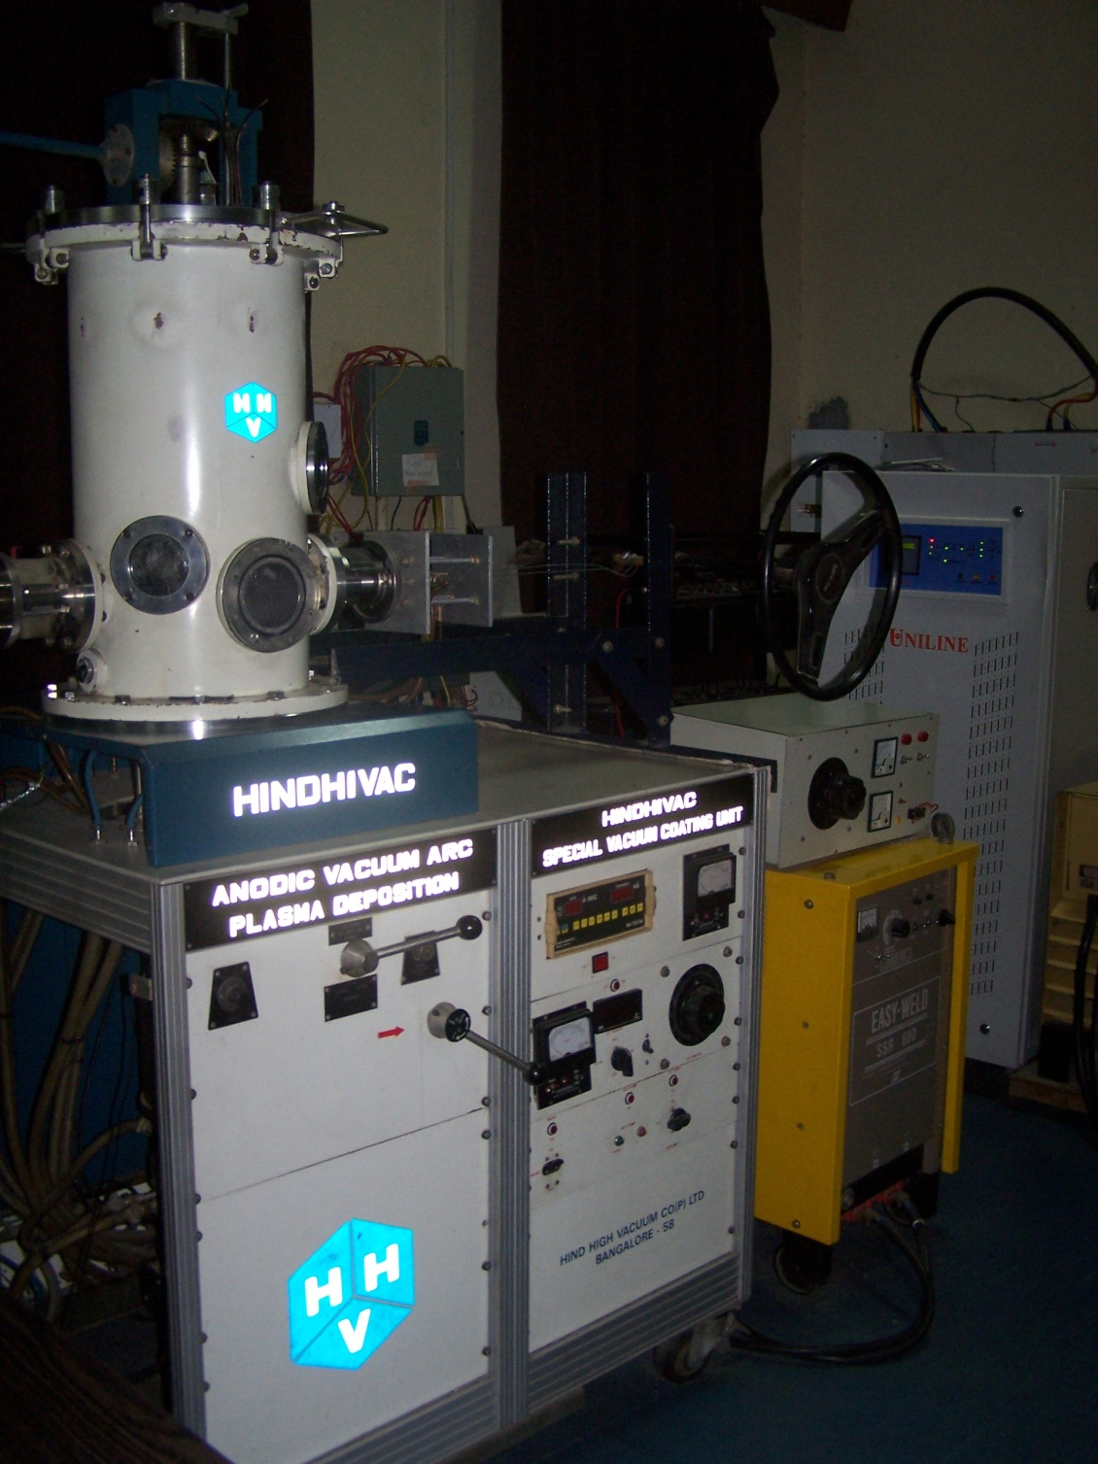
Anodic Vacuum Arc Deposition System
Purchased under ISRO RESPOND project in 1998.
This is an arc plasma aided thin film deposition unit.
The system has been in use for depositing thin films of metals and metal alloys primarily.
It offers some definite advantages like macroparticle free deposition, very high deposition rate, low system cost as well as running cost.

Slide 6
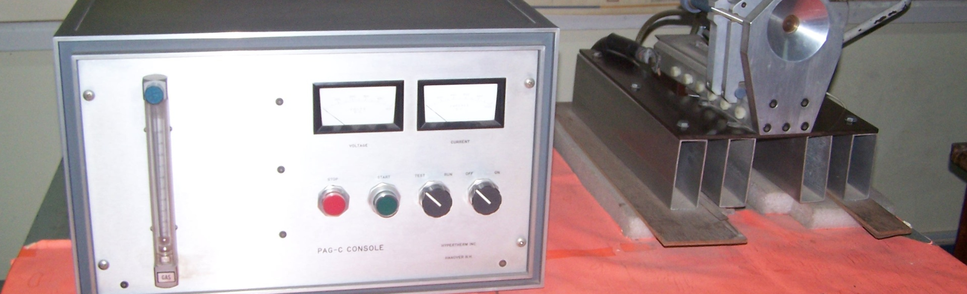
Cascaded Anode Plasma Arc Generator
We have an atmospheric pressure arc plasma generator intended for studies in basic arc plasma phenomena.
It is a wall stabilized thermal plasma device that has application in arc cutting, welding, drilling, spheroidization, hazardous waste disposal etc.

Slide 7
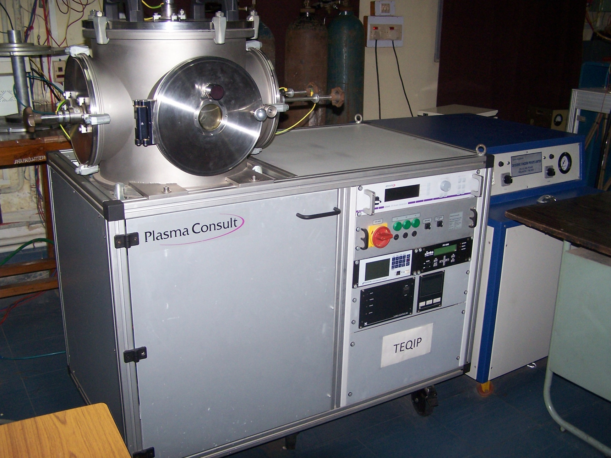
Radio frequency magnetron sputtering system
Is a three-target thin film deposition system capable of depositing single as well as multilayer thin films of a variety of materials.
Reactive deposition like oxides, nitrides and carbides have been carried out using this system.

Slide 8
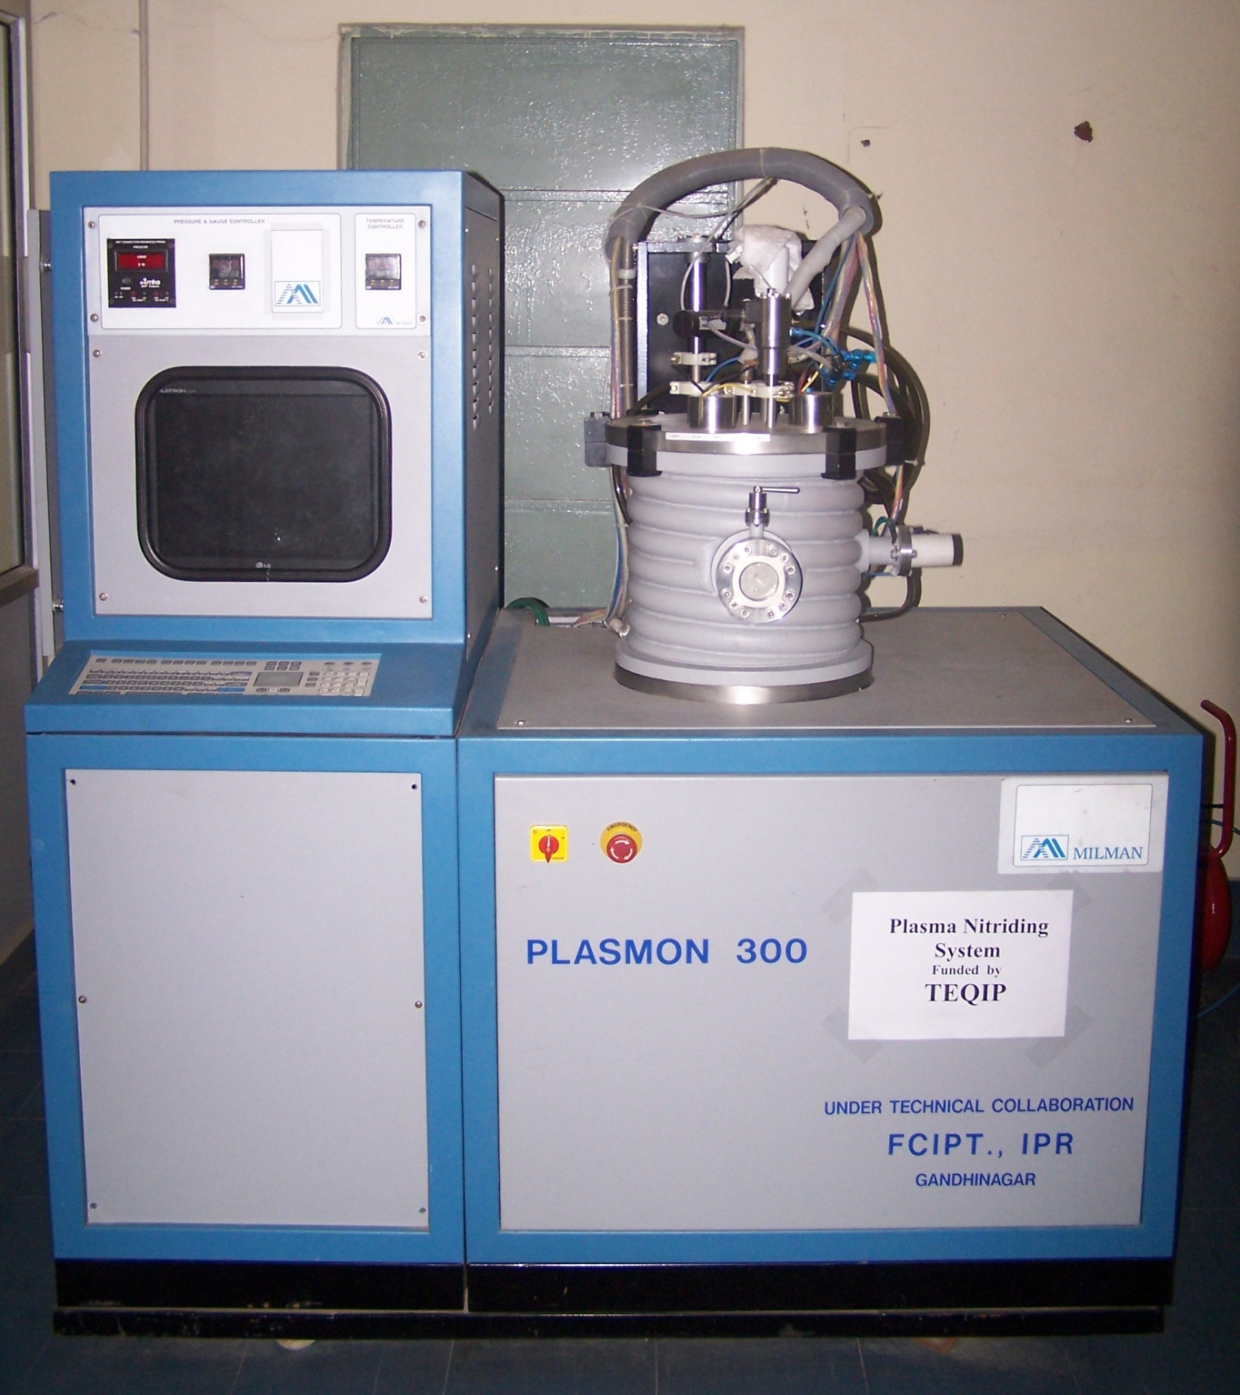
Plasma Nitriding System
Purchased under TEQIP
thermochemical case hardening process
to increase wear resistance, surface hardness

Slide 9
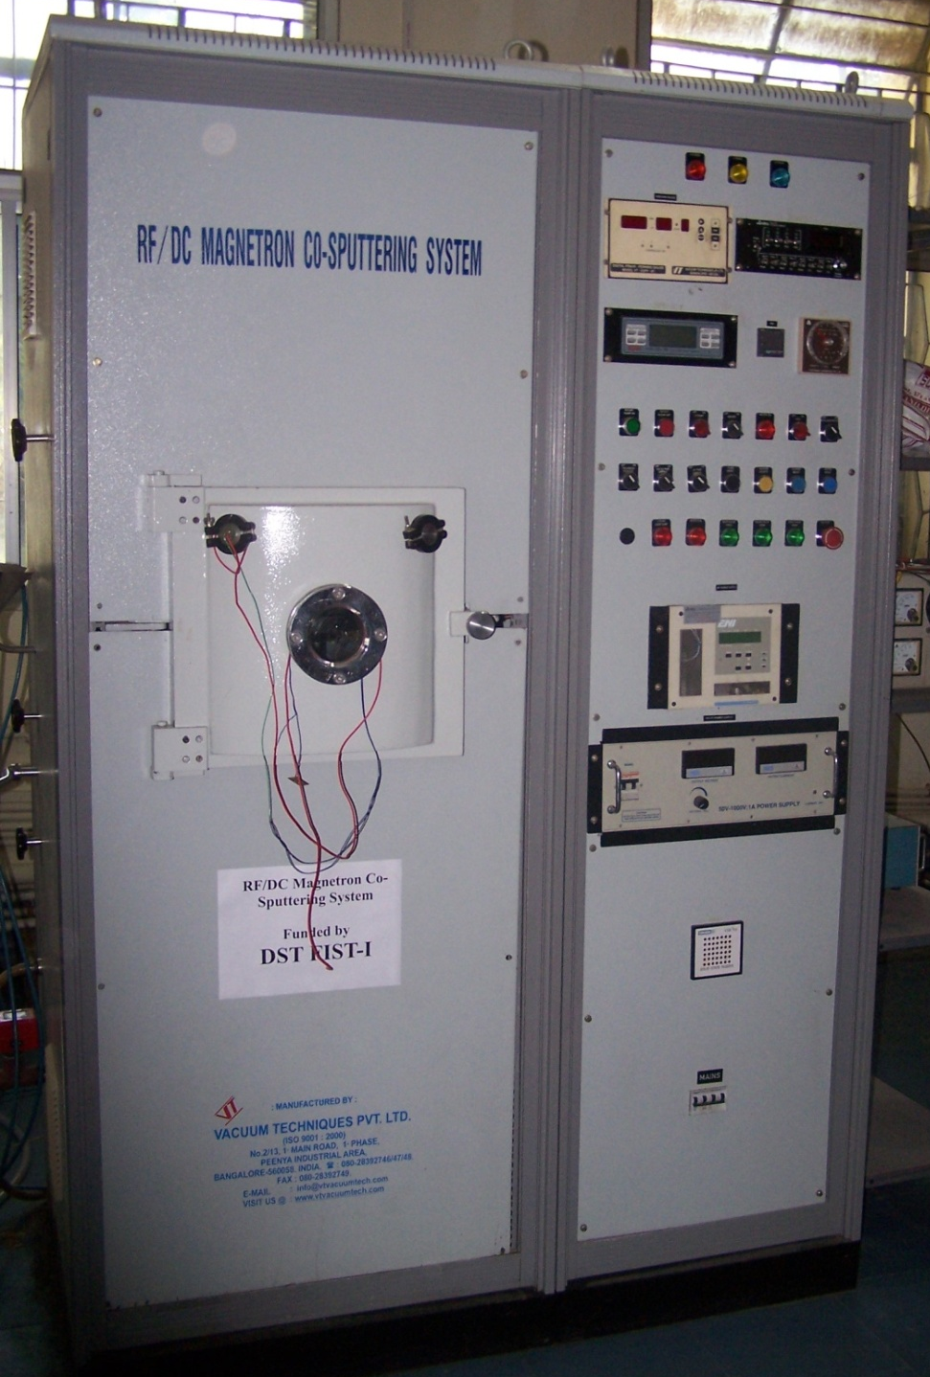
Co-sputtering System
This system was purchased under DST-FIST during 2006.
The system has been in use for co-sputtering multi-component thin films, reactive deposition and can as well be used for multilayer thin films.

Slide 10
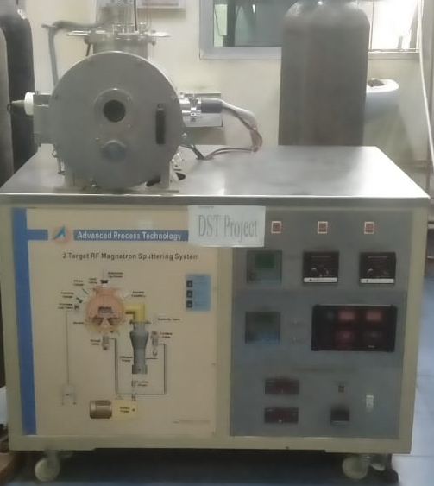
Double-Target Magnetron Sputtering
The unit was procured under DST project and finds application in developing thin films of GMR and CMR materials.
It requires small sized targets, particularly suited for depositing films of expensive materials composition.

Slide 11
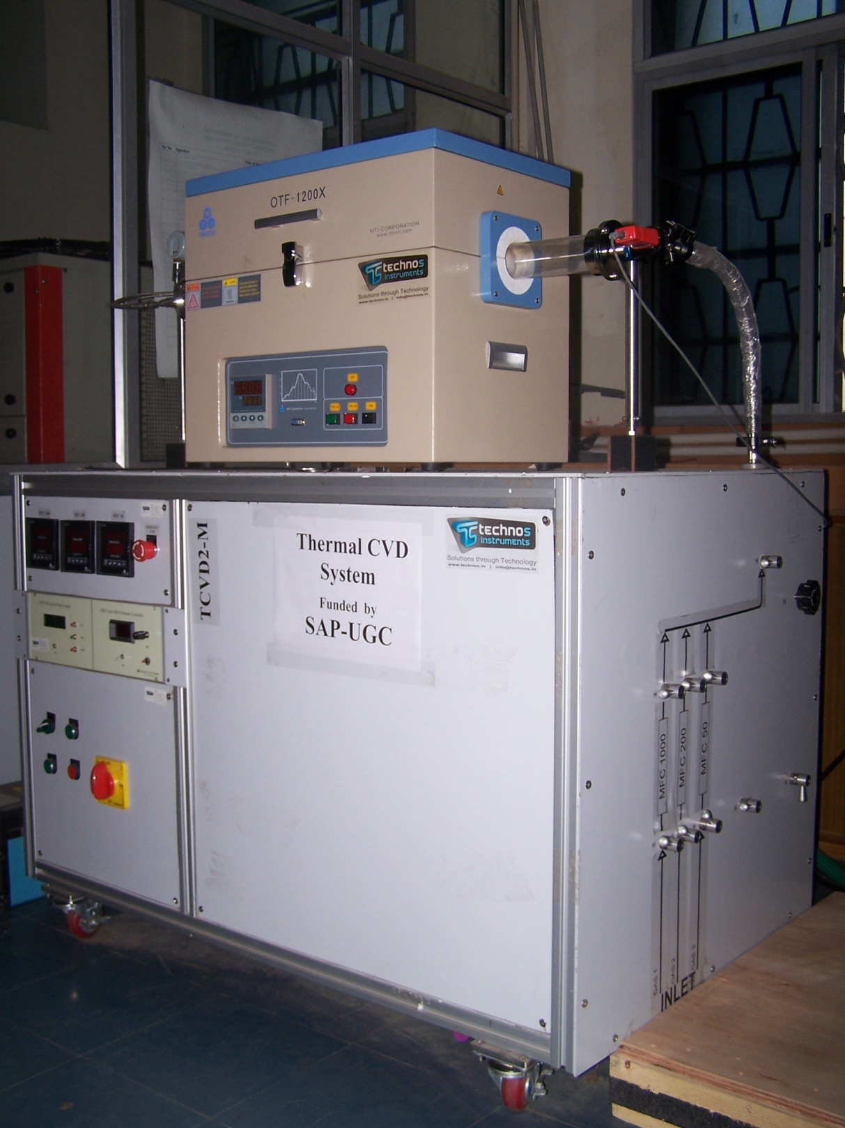
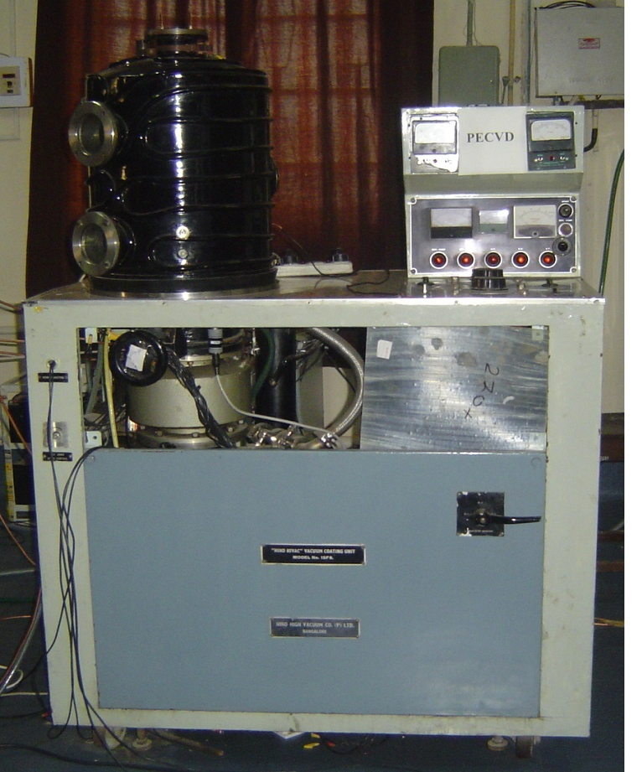
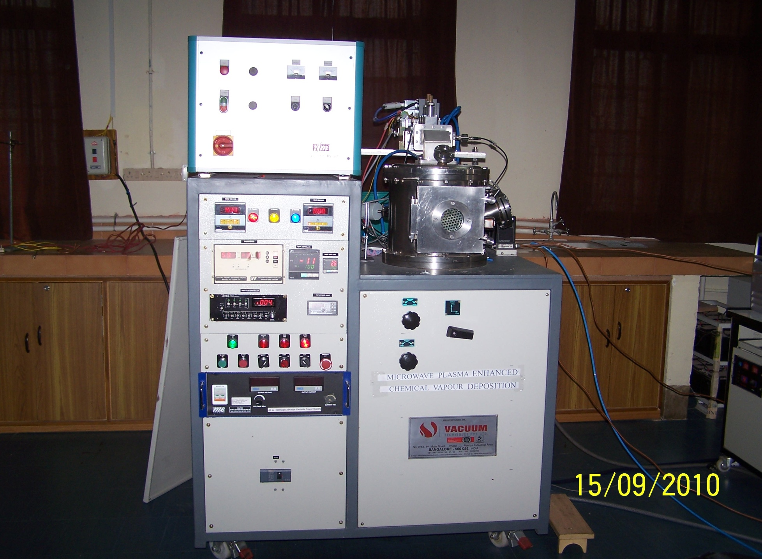
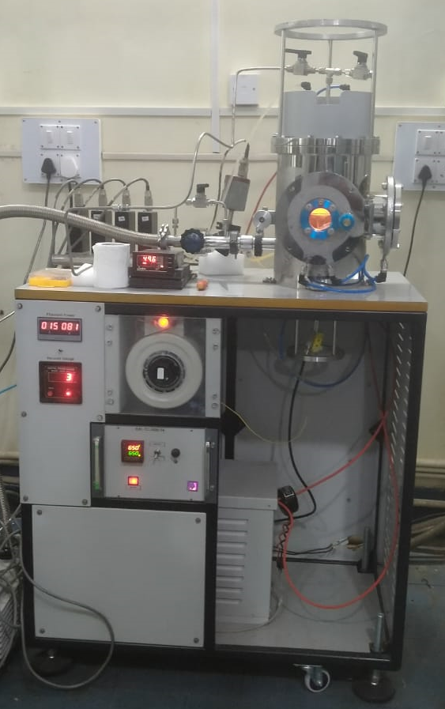
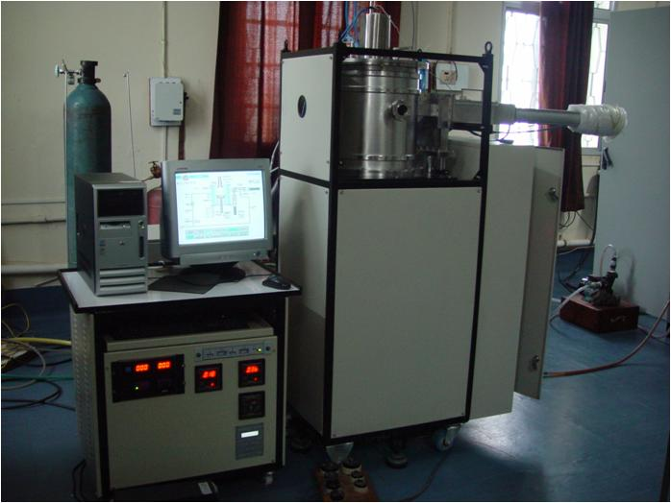
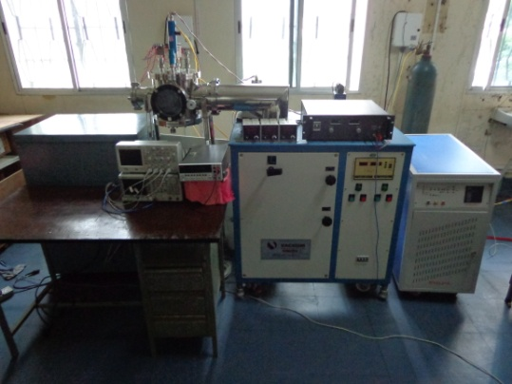
CVD
We are equipped with a variety of CVD units viz., DC CVD, Thermal CVD, PECVD, Microwave CVD and Hot Filament CVD.
These units are being used for development of DLC films, NCD and UNCD Films, CNT and Graphene, Nanowires and 2-D semiconducting structures, etc.

Slide 12
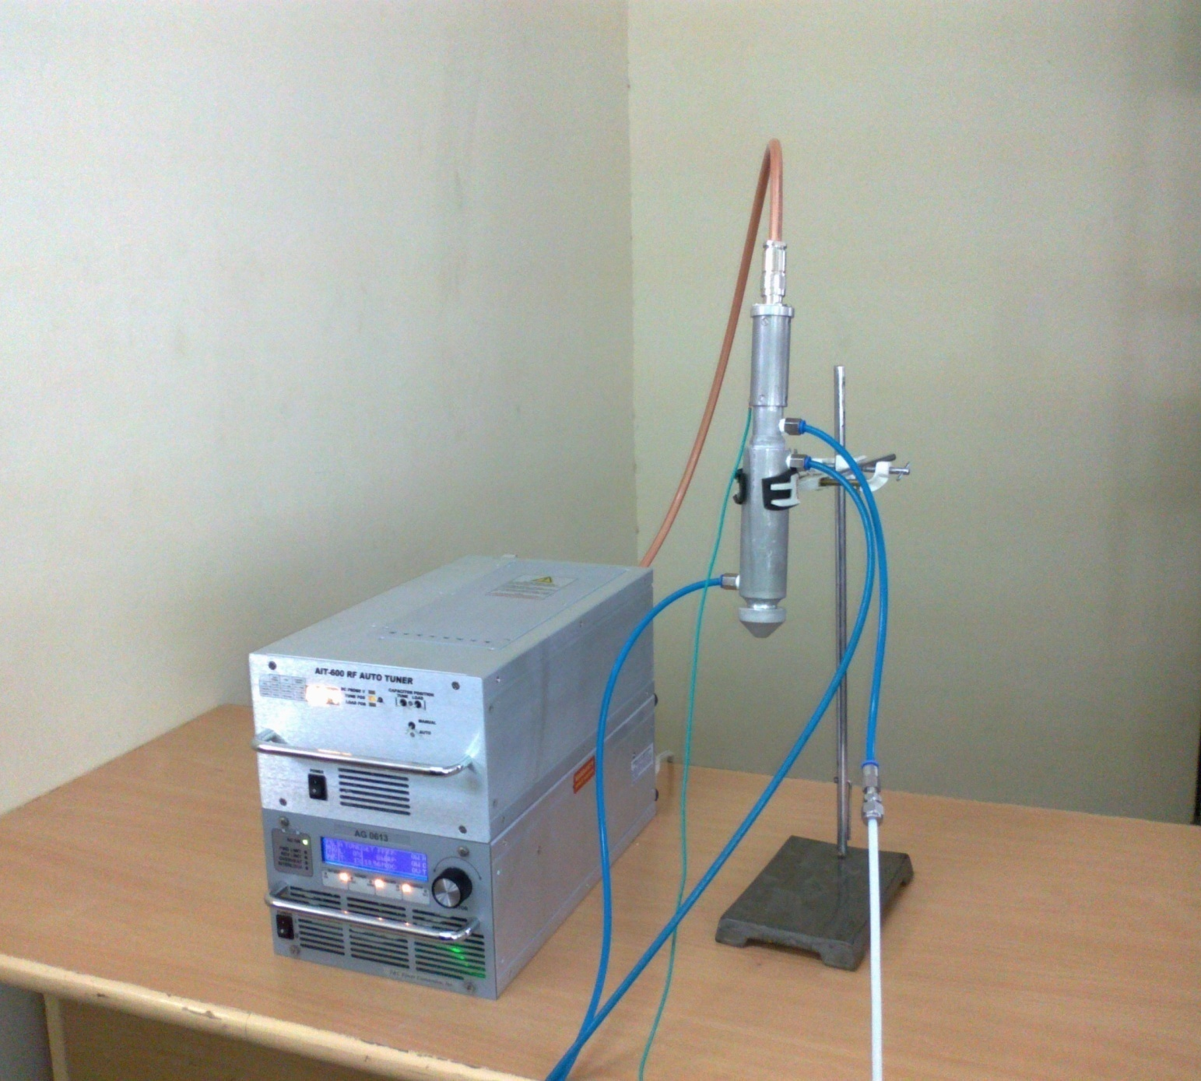
Atmospheric Pressure Plasma Jet
Studies on Cold Plasma Processing of Materials at atmospheric pressure.

Slide 13
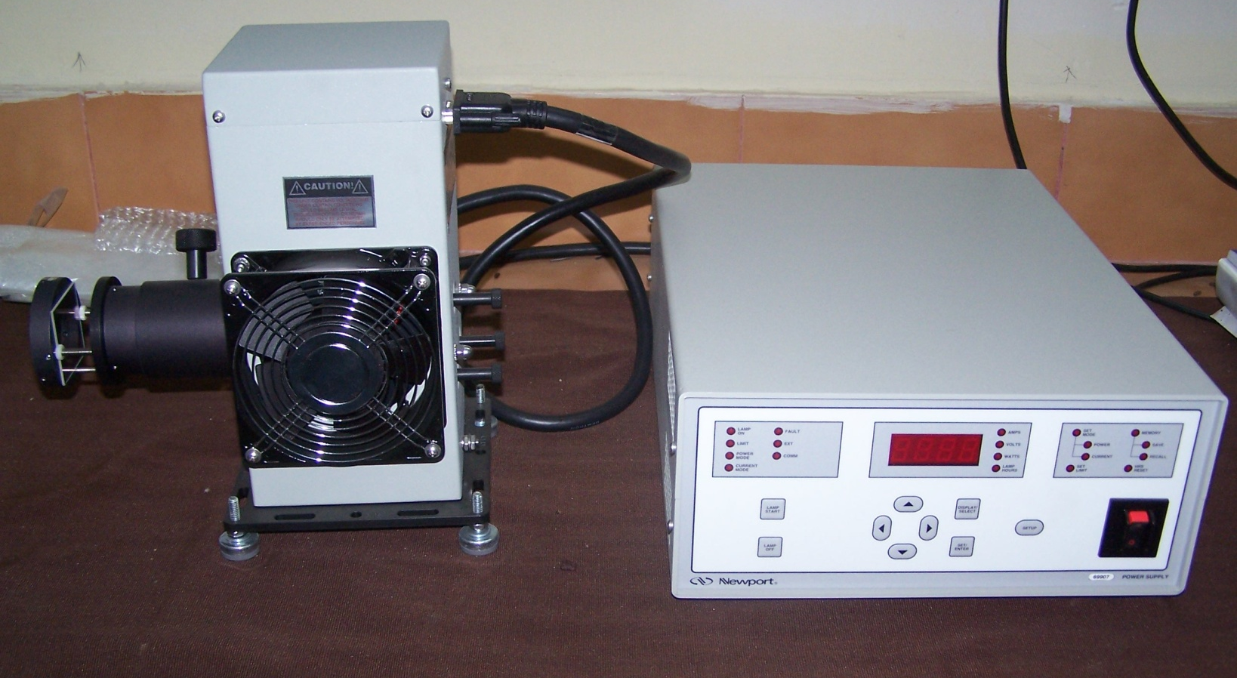
Solar Simulator
Characterization and standardization of solar cells developed in the lab.

Slide 14
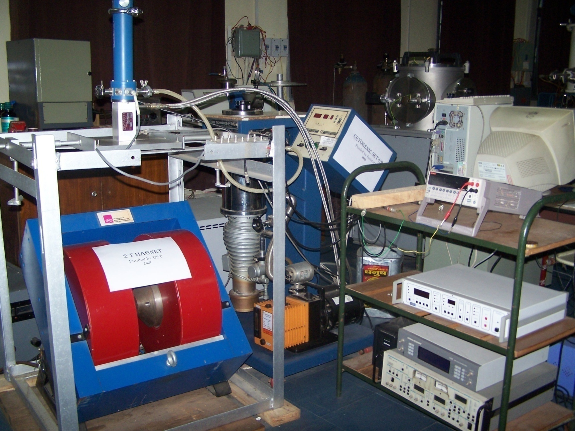
Closed cycle liquid helium cryostat with 2-T electromagnet
Low temperature conductivity measurement of samples in the temperature range of 10 K to 350 K

Slide 15
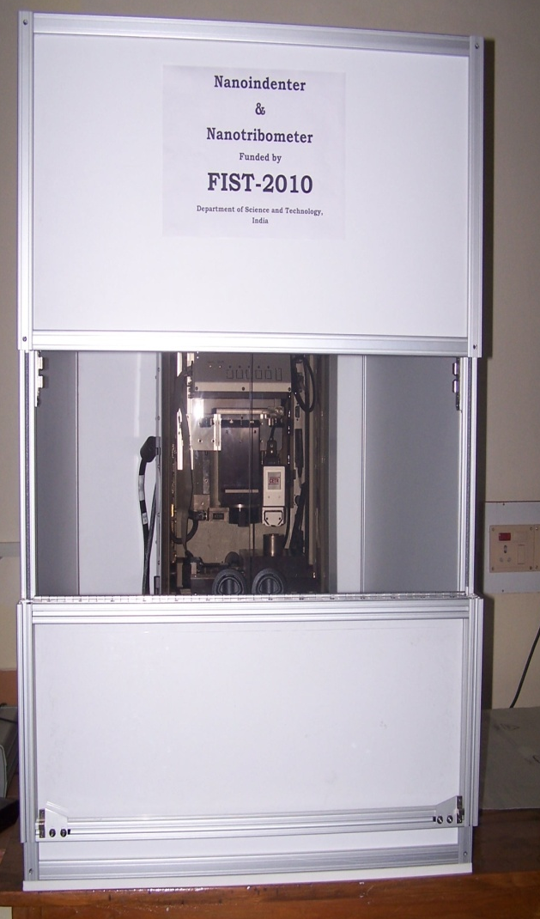
Nano-indenter
Nanoindenter is used to characterize thin films, intended for coatings on cutting tools, thermal barrier coatings, microhardness in industrial quality and control, scratch and wear resistance, etc.

Slide 16
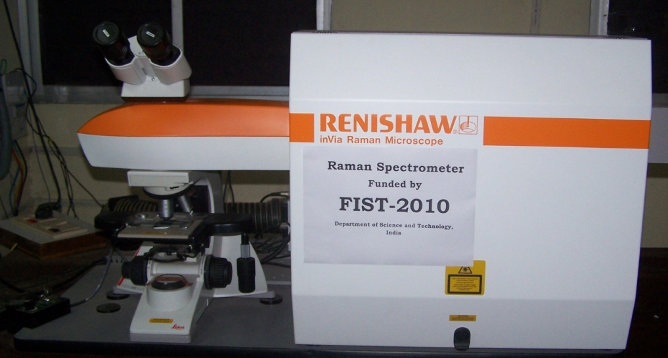
Raman Spectrometer
Purchased under the FIST program of DST.
Characterization of samples for their chemical composition and structure.

Slide 17
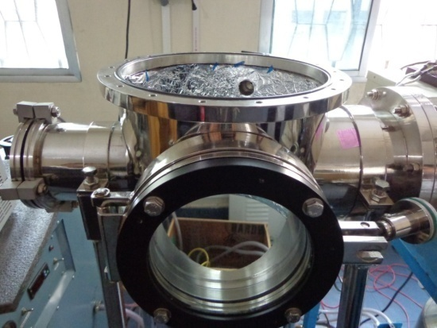
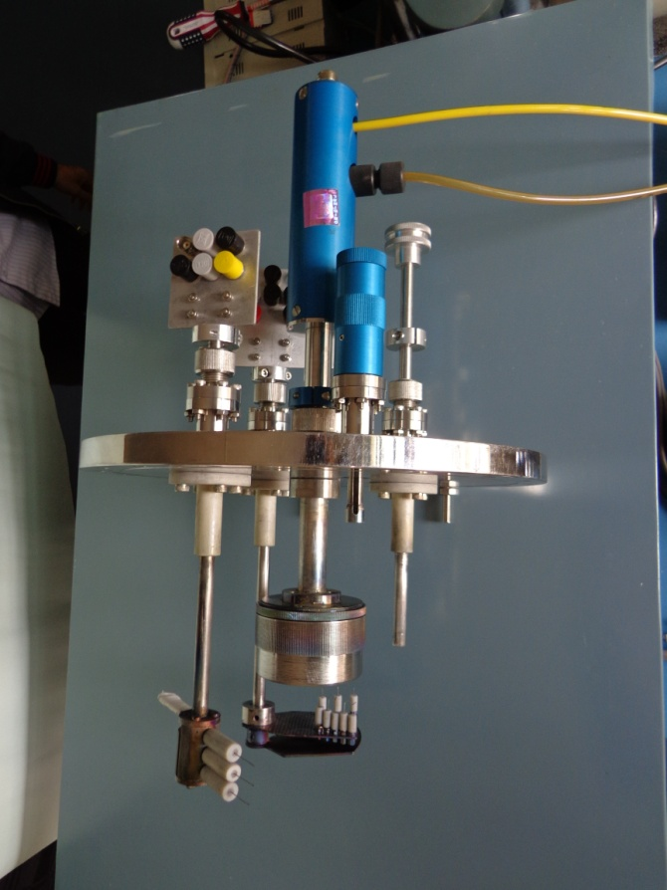
Plasma diagnostics unit
Studies on basic plasma characteristics

Slide 18
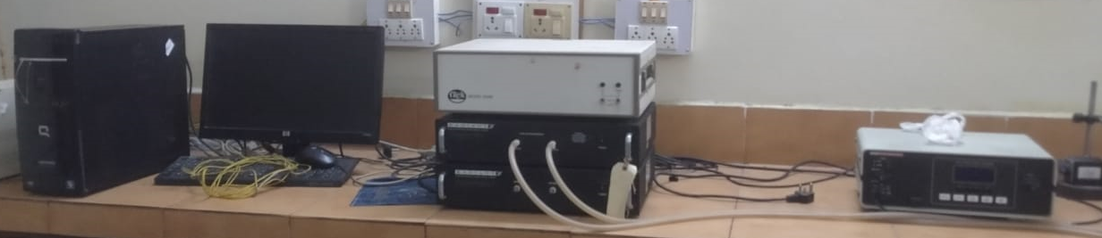
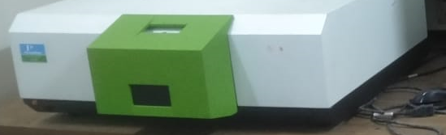
Additional Facilities
Apart from these, we have several other vital equipment viz.
Ferroelectric Loop Tracer 20kV
Impedance Analyzer
LCR Meter
D33 Meter
Keithley Parameter Analyzer SCS-4200
UV-Vis Spectrometer
Photoluminescence Spectrometer

Slide 19
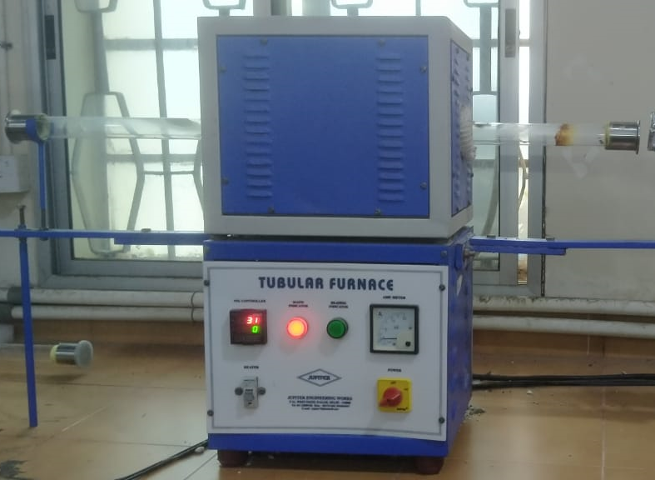
Furnaces
Ball milling system and a host of furnaces for material syntheses are also available in the department, included are the following:
Box furnace 1700 ⁰C
Muffle furnace 1800 ⁰C and
Tubular furnace 1700 ⁰C to name a few.

Slide 20
Areas of Expertise
Photonics, Nonlinear Optics
Optical communications
Nanophotonics
Solitons, Nonlinear Plasma Physics
Laser Plasma Interactions
Bose Einstein Condensate
Opto-electronic Material and Devices
Physics and applications of 2-D Semiconductors
Instrumentation
Nanoceramics, Dielectrics
Relaxor Ferroelectrics, Fe RAM
Biopolymeric solids
Plasma Physics
Plasma diagnostics
Digital Holography
Cosmology
Image Processing
Non-destructive Testing
Optical Tomography
Materials Science
Surface & Interface Physics
Thin Films
Ion beam Mixing
Biomaterials
Nanotechnology
Functional materials
Low Temperature Physics
Superconductivity
Contd…

Slide 21
Areas of Expertise
Nonequilibrium Statistical Mechanics
Dynamics of supercooled liquids and glass transition
Collective behavior of self-propelled colloids
Rheology of complex fluids, Nanofluidics
Solar Cell
Carbon based materials
Nano-Optics & Nanofabrication
Atmospheric Physics
Numerical Modeling
Artificial Neural Network
Air Pollution Studies
Chemical Transport Modeling
Aerosol related Studied
High Energy Physics (Theory)
Topological Insulators
Weyl Semi-Metals
Transition Metal Dichalcogenides
Two-Dimensional Materials
Low Temperature Electrical Transport Magnetoresistance
Shubnikov-De Haas Oscillations
Single Crystal Growth by Chemical Vapour Transport Method and Modified Bridgman Method
Plasma Physics and Bioelectromagnetism Data Analytics in the Healthcare Domain
Engineering Science

